Slide 1

ÇANKAYA UNIVERSITY MULTIDISIPLANARY PROJECT ME408 Innovative Engineering Design And Implementation FOAM CUTTING MACHINE
ADVISORS:
Dr. Samet AKAR
Yavuz Suat BENGÜR
TEAM MEMBERS:
Hanife SANCAR
Mert Eren ESER
Muhammet KOÇ
Doğukan KARATOP

Slide 2
FOAM CUTTING MACHINE
CONTENT
Introduction
Project Analysis
-Understanding the Project
-Project Team and Roles
-Literature Survey
-Goal Objectives and Deliverables
-Schedule and Plan
Requirement Analysis
-Technology Survey
-Requirement Breakdown
Design Specifications and Concept Development
-System Block Diagram
-System Design Specifications
-Sub-System Specifications
Procurement (Material, Equipment)
Conclusion

Slide 3
FOAM CUTTING MACHINE
Project Analysis
Understanding the Project
Project is called "Foam Cutting Machine".
Preparing prototypes in advance and seeing its suitability for implementation in major sectors such as art design, aircraft modeling and advertising is one of the best methods to eliminate future costs and time losses.
Designed to cut 2-D and approximately 400x400x400mm 3-D foam parts in approximately A2 paper sizes (460x440mm)
Cutting item type nickel-chromium alloy wire
Direction is that X,Y,Z
Strafor foam

Slide 4
FOAM CUTTING MACHINE
Project Team and Roles
PROJECT TEAM
Doğukan KARATOP
Mert Eren ESER
Hanife SANCAR
Muhammet KOÇ
Team Leader
Muhammet KOÇ
Mechanical Design
Hanife SANCAR
Electromechanical Design
Muhammet KOÇ
Electronic System Design (HW+SW)
Doğukan KARATOP
Design, Simulation and Technical Drawing
Hanife SANCAR
Analysis
Mert Eren ESER
Calculation, Presentation and Report
Team Work
Business Development & Marketing
Muhammet KOÇ
Cost-Schedule Control
Mert Eren ESER
Procurement
Mert Eren ESER
System Design
Team Work

Slide 5
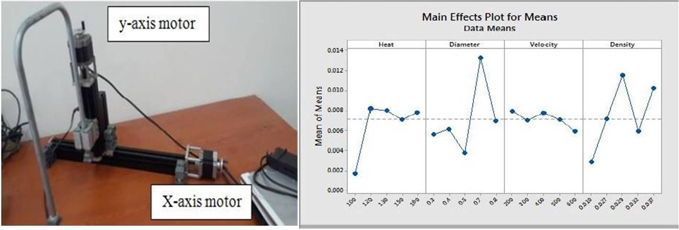
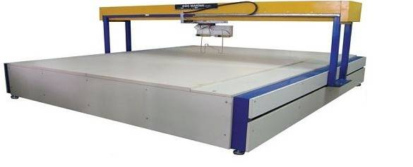
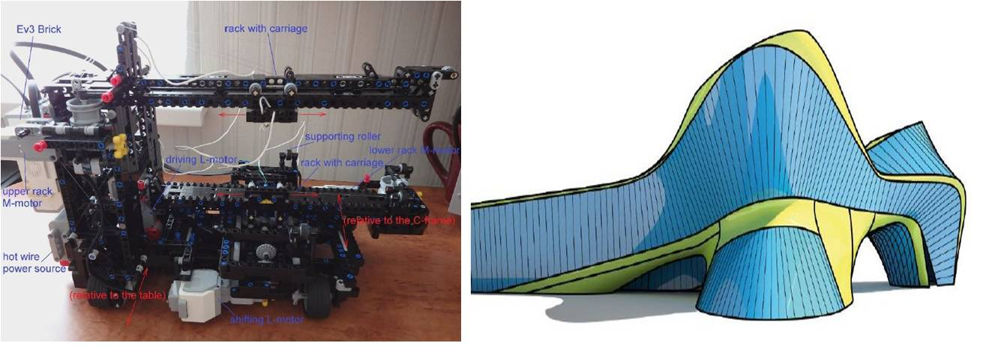
FOAM CUTTING MACHINE
Literature Survey

Slide 6
FOAM CUTTING MACHINE
Goal Objectives and Deliverables
Cutting 2D and 3D parts
Prepare prototype for project
Reducing cost
Avoid manifacturing errors

Slide 7
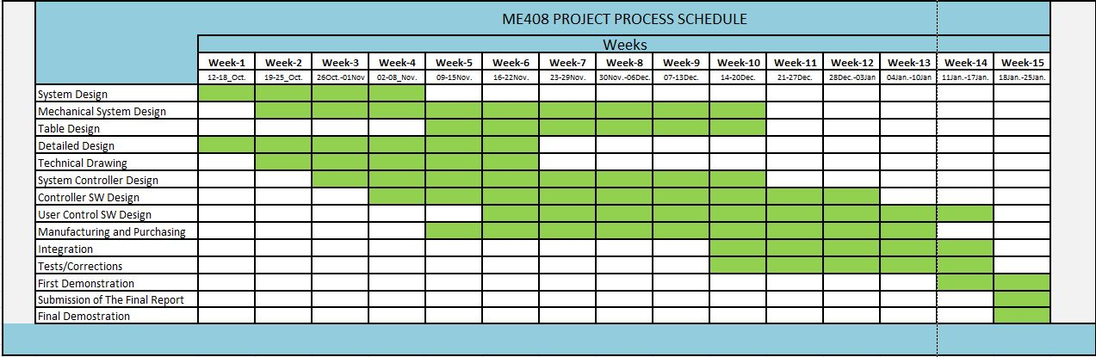
FOAM CUTTING MACHINE
Schedule and Plan

Slide 8
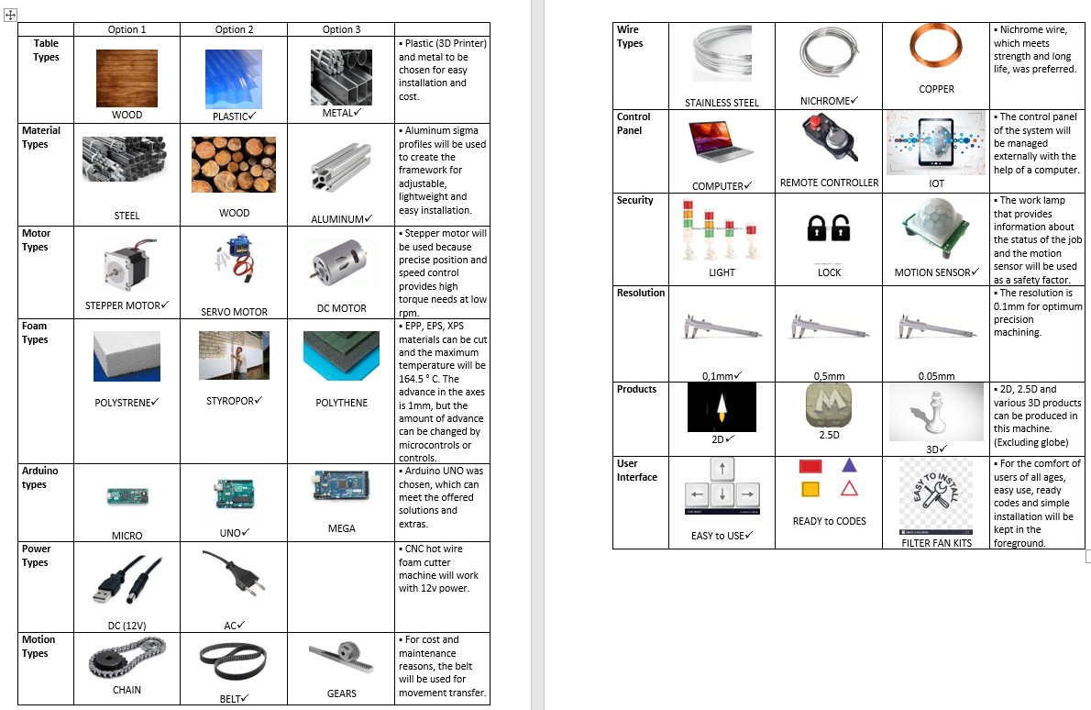
FOAM CUTTING MACHINE
Requirement Analysis
Technology Survey

Slide 9
FOAM CUTTING MACHINE
Requirement Breakdown
Conical, curved and other complex shapes could be cut on this machine,
Rotating table could be added to provide additional axis to work on and possibility to cut various round objects
Hot wire, or a special type of resistance wire will be used for cutting process.
System will be controlled by a microcontroller
Microcontroller can be controlled/re-programmed by a LapTop computer
User controlling can be done by LapTop Computer
User Application and Microcontroller programs can work on a latest Windows OS.

Slide 10
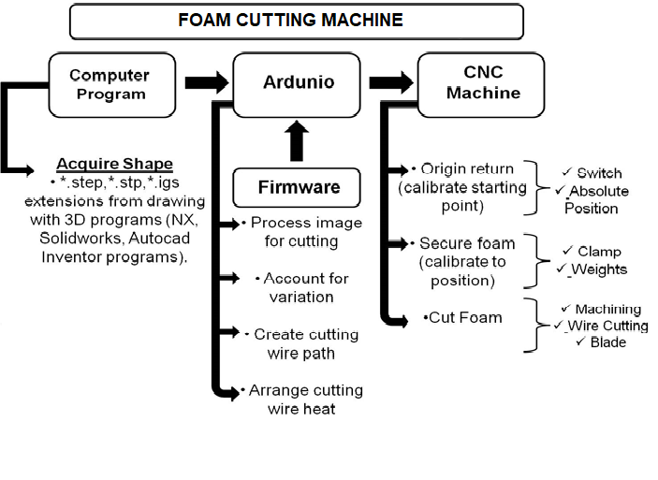
FOAM CUTTING MACHINE
Design Specifications and Concept Development
System Block Diagram

Slide 11
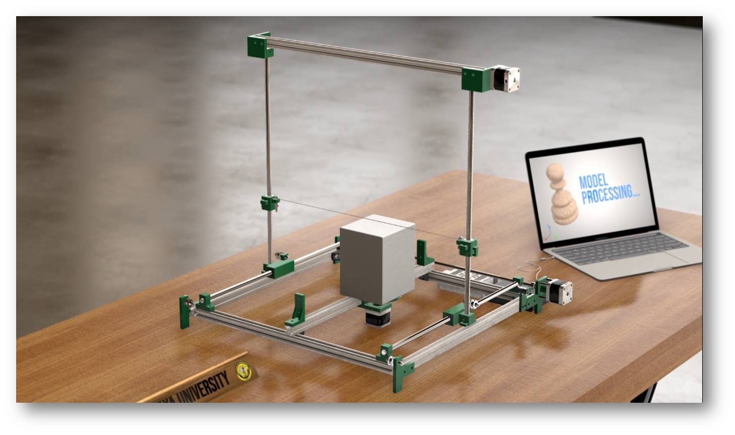
FOAM CUTTING MACHINE
Preliminary Design

Slide 12
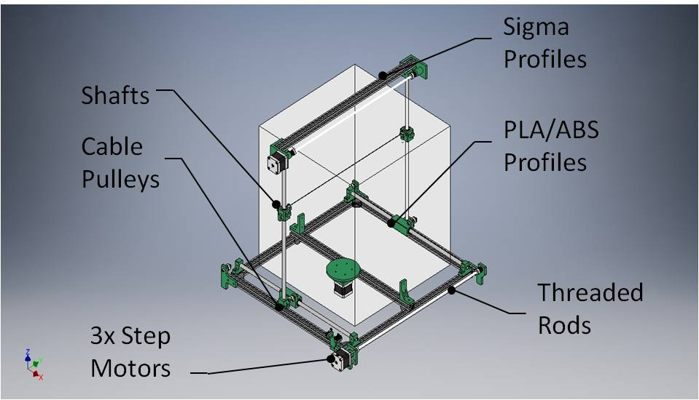
FOAM CUTTING MACHINE
System Design Specifications

Slide 13
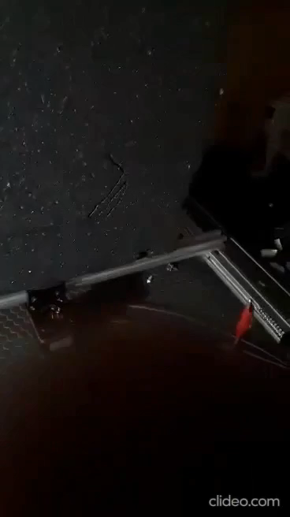
FOAM CUTTING MACHINE
System Design Specifications

Slide 14
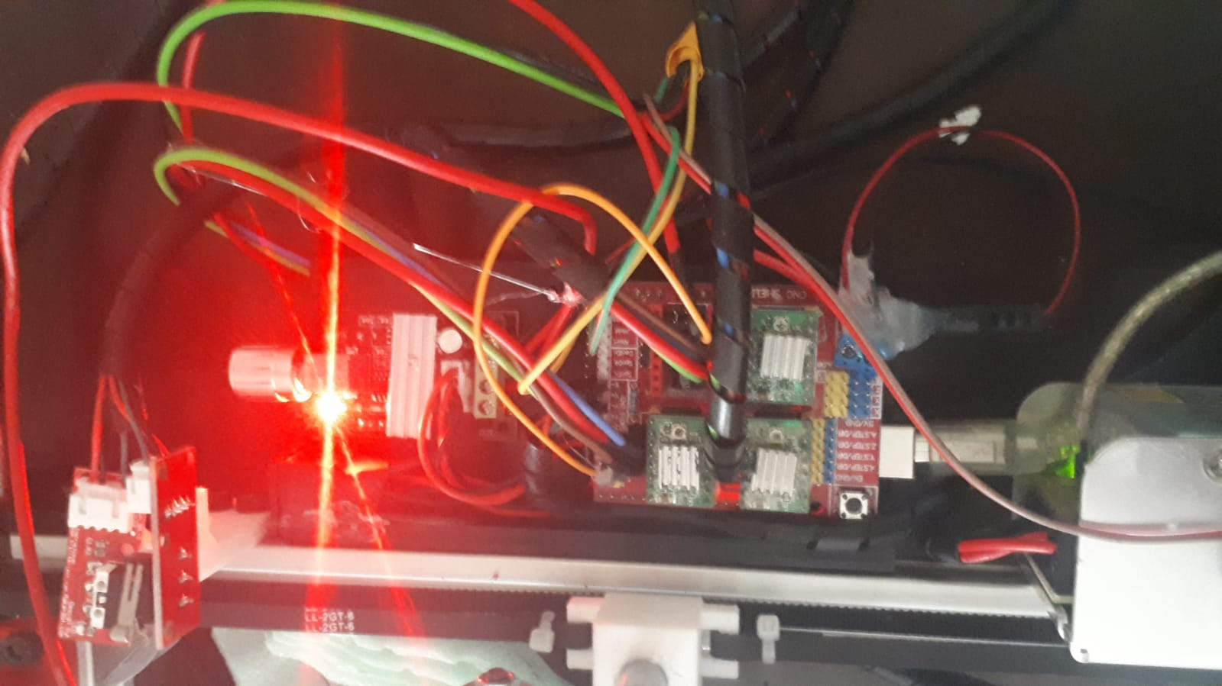
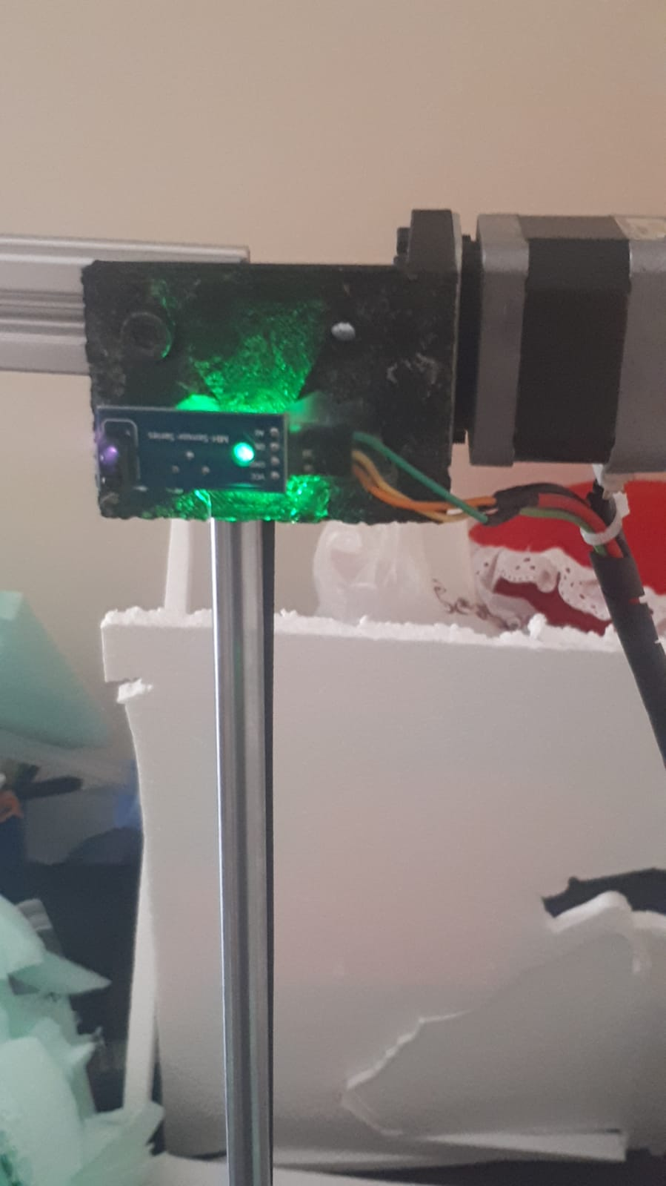
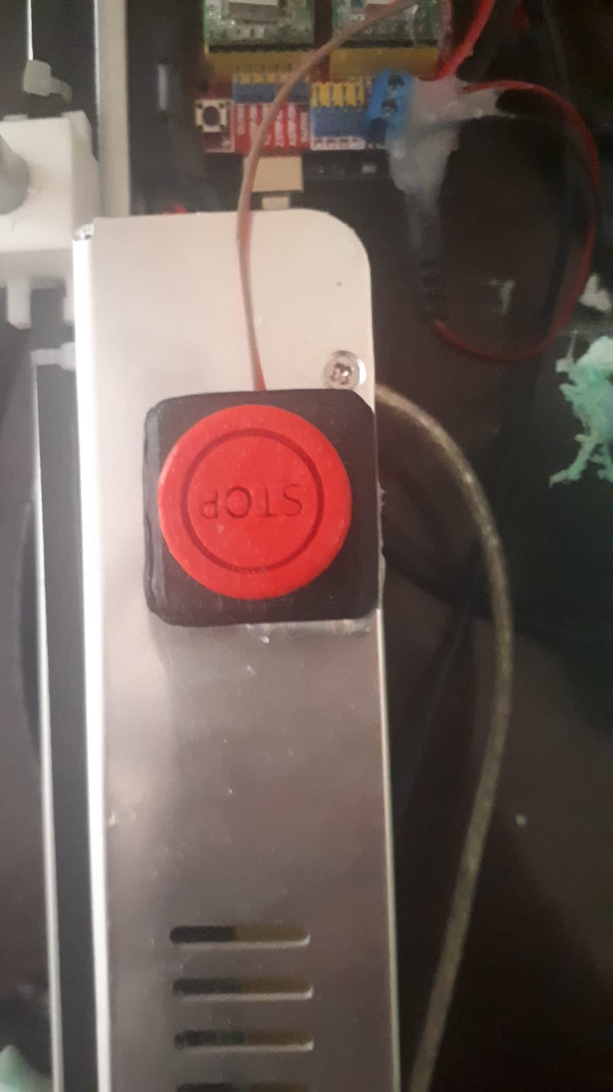
FOAM CUTTING MACHINE
Sub-System Specifications

Slide 15
FOAM CUTTING MACHINE
Procurement (Material, Equipment)
Item List
MEKANİK
Name | Nitelik | Adet | Fiyat
T-Slot Alüminyum Profil | 20x20x500mm | 6 | 70,82 ₺
Paslanmaz Çelik Mil | Ø10x500mm | 4 | 153,48 ₺
Köşe Bağlantı Profili (T-Slot için) | 20x20mm | 6 | 17,70 ₺
Kanal İçi Somun (T-Slot için) | M5 | 50 | 90 ₺
LM10UU-Lineer Rulman | Di:Ø10mm,Dd:Ø19mm, B:29mm | 6 | 56,64 ₺
GT2 - Kayış | W:6mm ve L:2m Kayış |  | 23,60 ₺
GT2 - Motor Kasnak | 2x5mm,Diş:16 Al Kasnak |  | 31,80 ₺
GT2 - Avare Kasnak |  | 1 | 9,44 ₺
625ZZ Bilyeli Rulman | Di:Ø5mm,Dd:Ø16mm, B:5mm | 2 | 15,34 ₺
Dişi-Erkek Yükseltme Parçası( Aralayıcı) | M3x30mm-Pirinç Alaşımlı | 4 | 6,00 ₺
Yay | Paslanmaz Çelik | 2 | 5,90 ₺
Isıtıcı Tel |  |  | 5,00 ₺
Trapez Vida | M8x500mm, Vida Adımı:2mm,Paslanmaz Çelik | 2 | 125,00 ₺
Vida somun | M3x30mm, Paslanmaz Çelik | 8 | 1,60 ₺
Vida somun | M4x25mm, Paslanmaz Çelik | 4 | 0,80 ₺
Vida somun | M4x30mm, Paslanmaz Çelik | 4 | 0,80 ₺
Vida somun | M5x10mm, M5x12mm, Paslanmaz Çelik | 40 | 8,00 ₺
Vida somun | M5x15mm, Paslanmaz Çelik | 8 | 1,60 ₺
Vida somun | M5x25mm, Paslanmaz Çelik | 4 | 0,80 ₺
Vida somun | M5x30mm, Paslanmaz Çelik | 4 | 0,80 ₺
Ara Toplam: |  |  | 625,12 ₺
ELEKTRONİK
Ürün Adı | Nitelik | Adet | Fiyat
Step Motor | Nema 17, 200 adım | 3 | 105,00 ₺
Ardunio Uno | CH340 | 1 | 27,14 ₺
Uno CNC Sürücü Kartı | V1.0 | 1 | 15,00 ₺
Tekerlekli Limit Switch |  | 2 | 20,00 ₺
Power Jack |  | 1 | 5,00 ₺
PowerSwitch |  | 1 | 2,00 ₺
Step Motor Sürücü Kartı | A4988 | 3 | 30,81 ₺
DC-DC Dönüştürücü |  | 1 | 35,00 ₺
DC Güç Kaynağı | 12V, 5A, 60W | 1 | 92,00 ₺
Ara Toplam: |  |  | 332 ₺
Genel Toplam: |  |  | 957,07 ₺
Some of parts are created with 3D printer machine

Slide 16
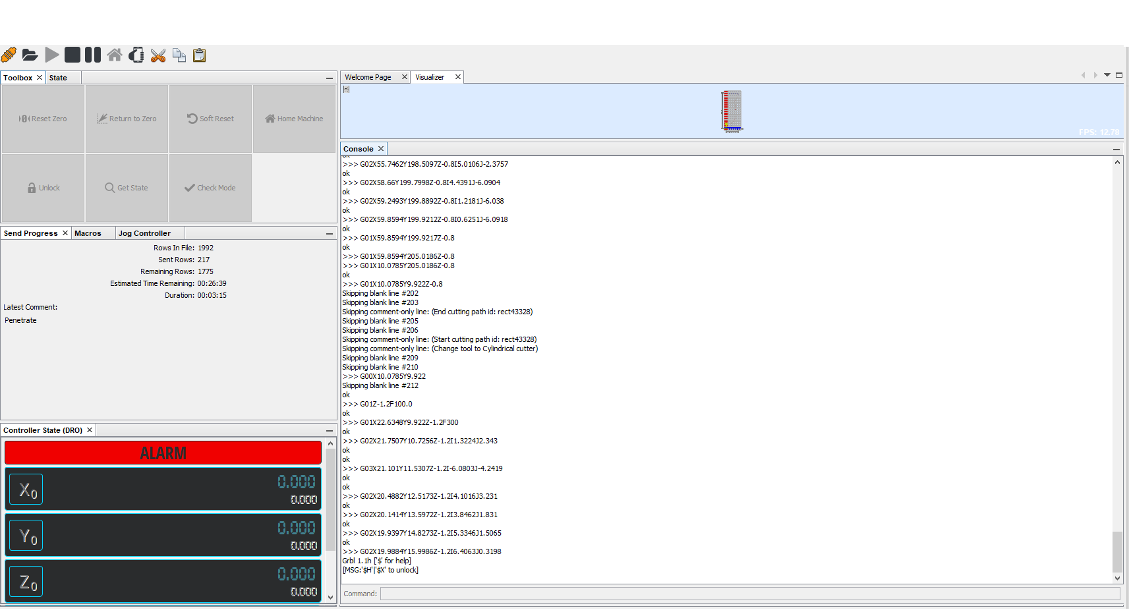
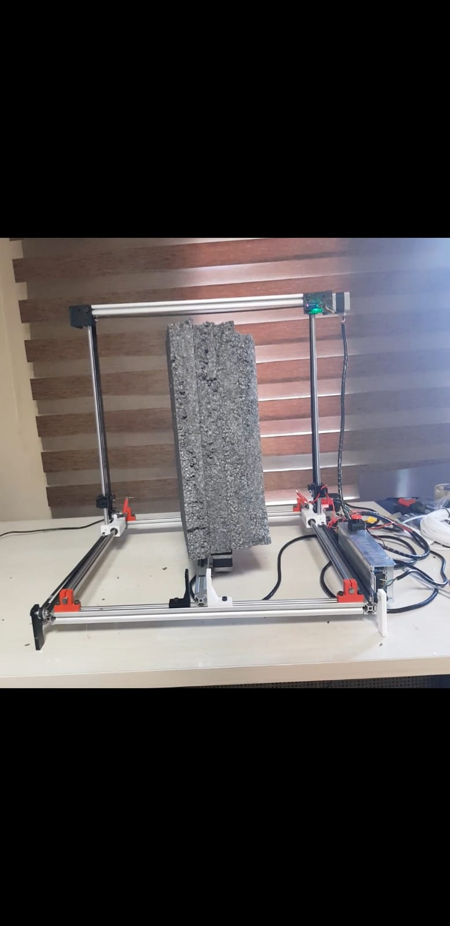
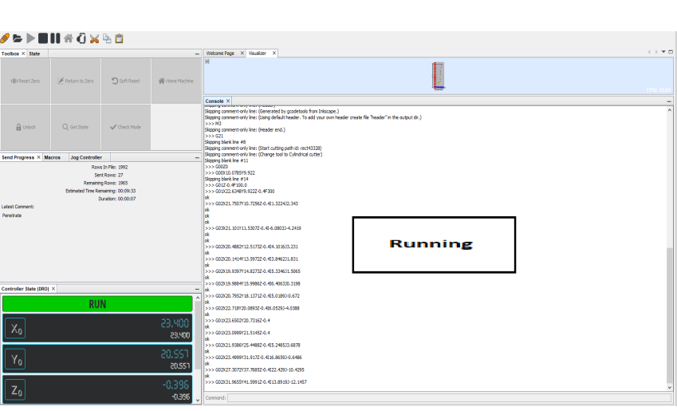
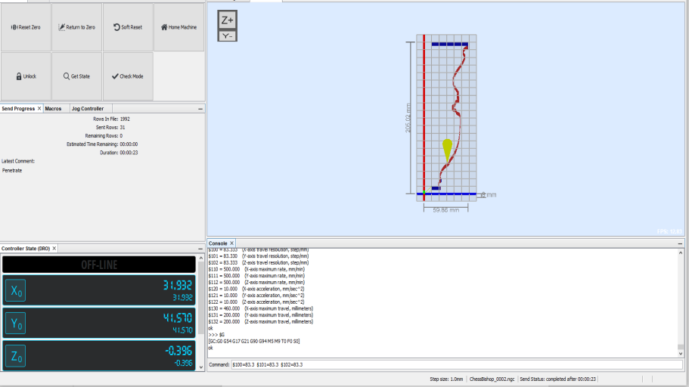
FOAM CUTTING MACHINE
System Integration

Slide 17
FOAM CUTTING MACHINE
Conclusion and Discussion
To Sum up, we have started to design our device by making a literature review about the project. We decided to choose mobile Foam Cutting Machine in terms of portability and usage.

Slide 18
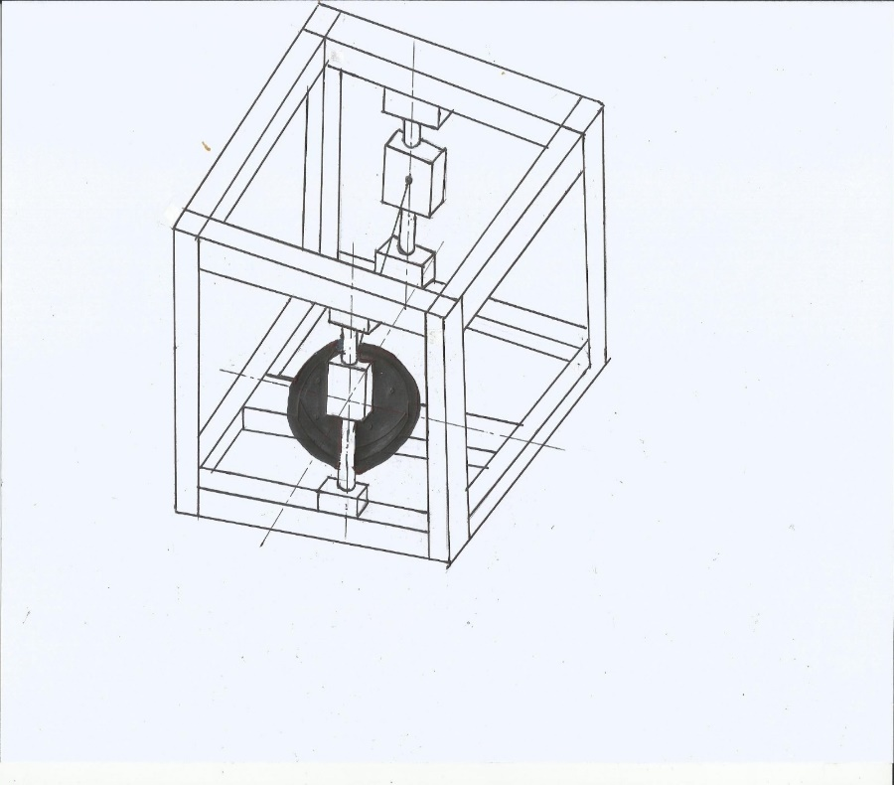
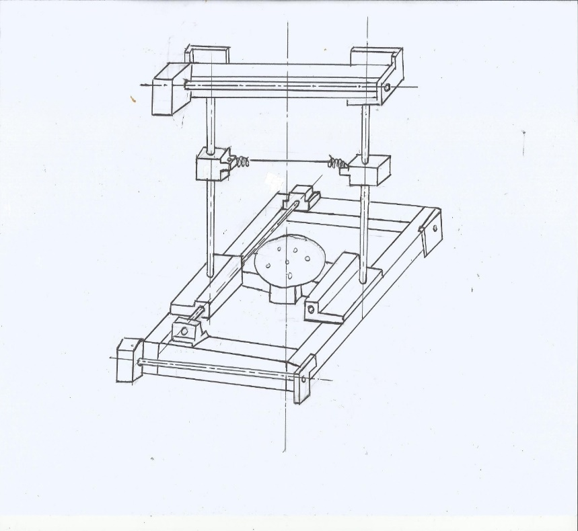
IllustratIon

Slide 19
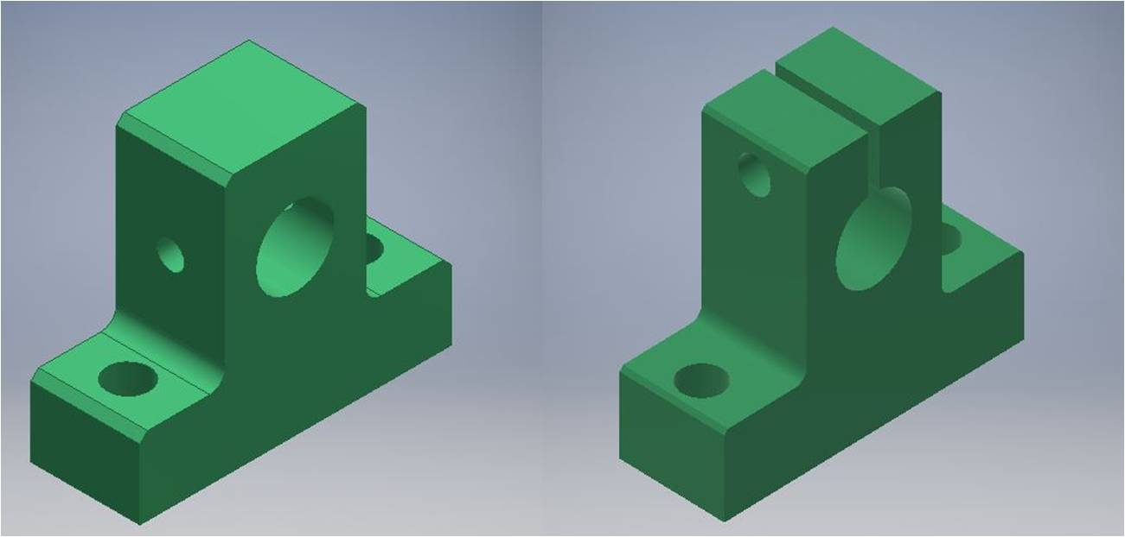
revısıon

Slide 20
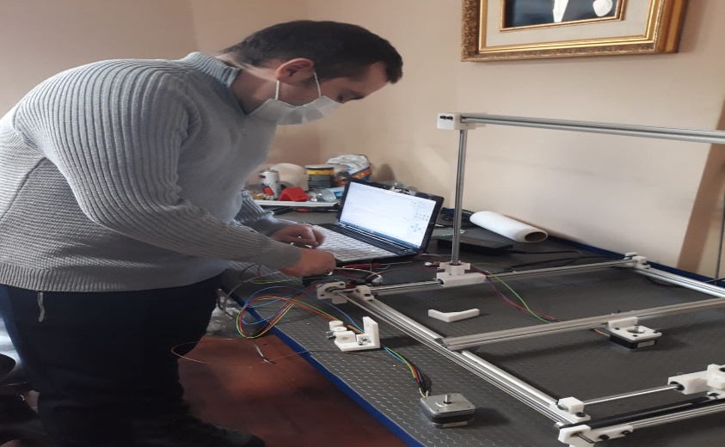
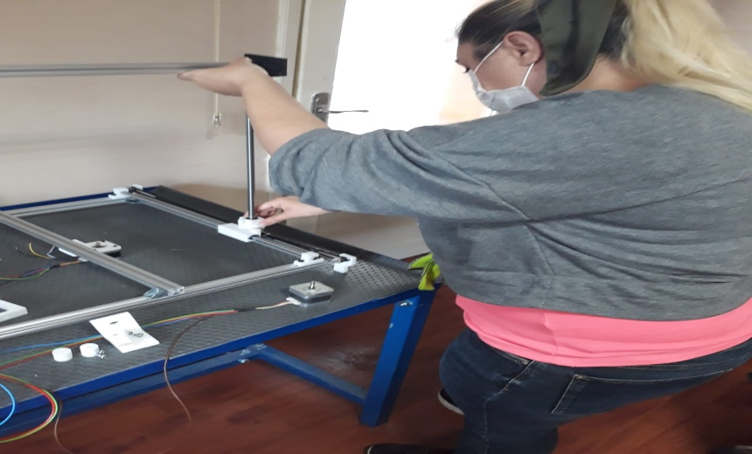
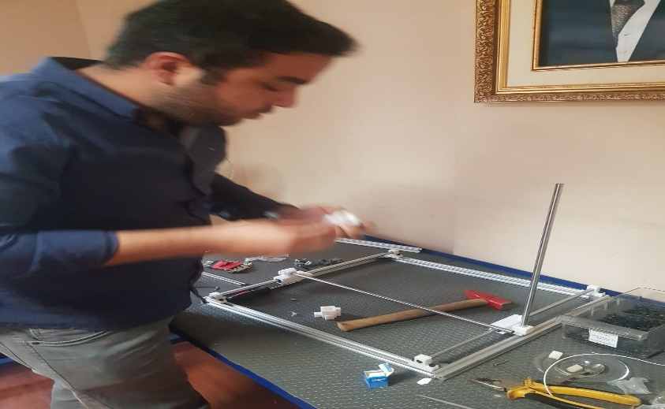
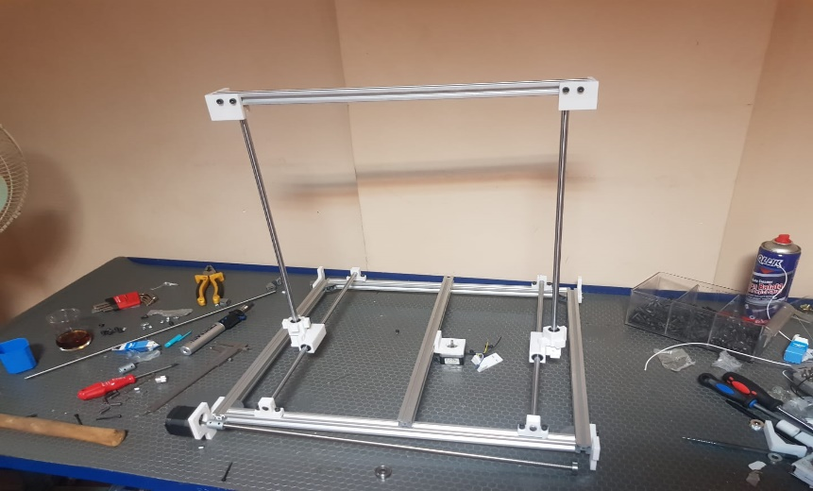
WORKSHOP

Slide 21
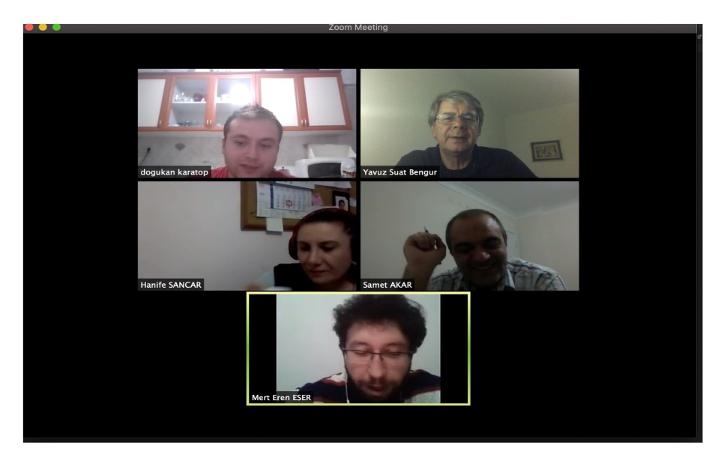
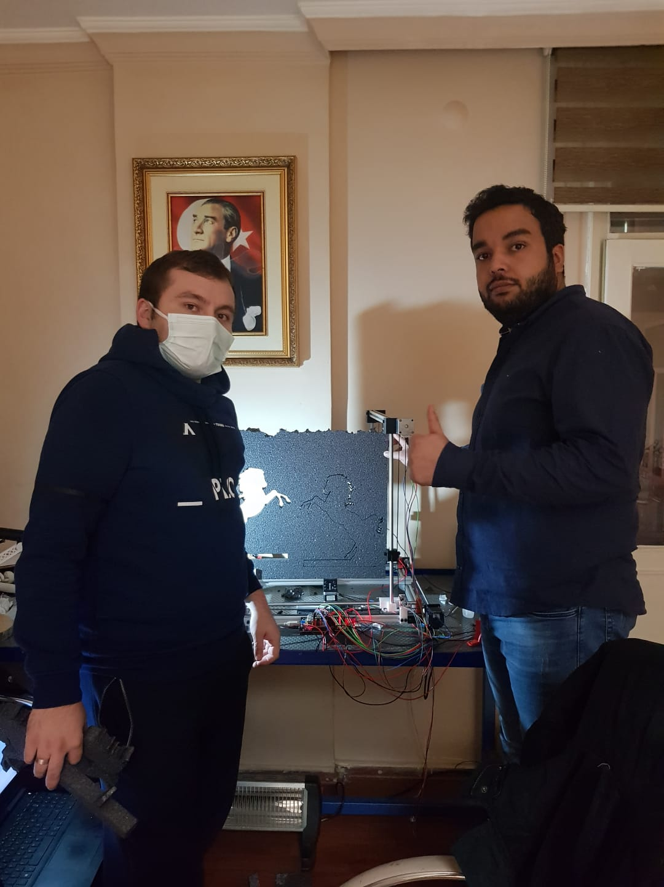
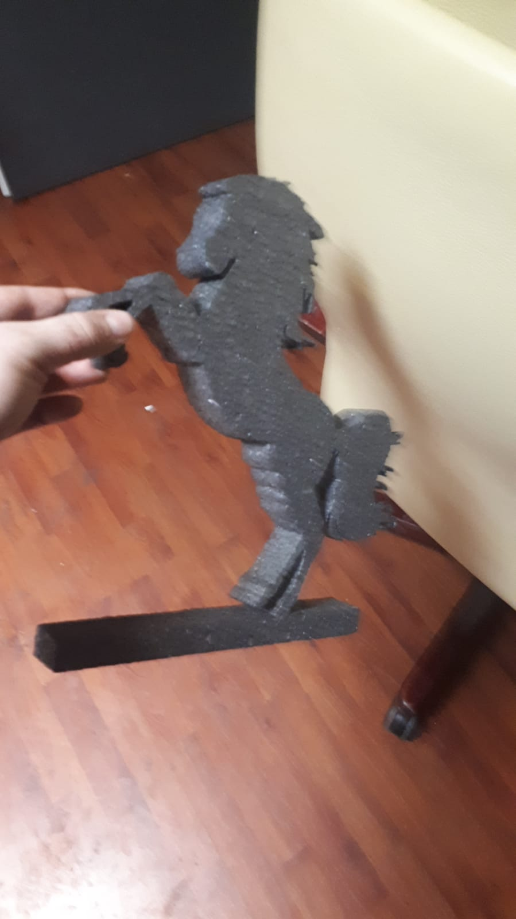
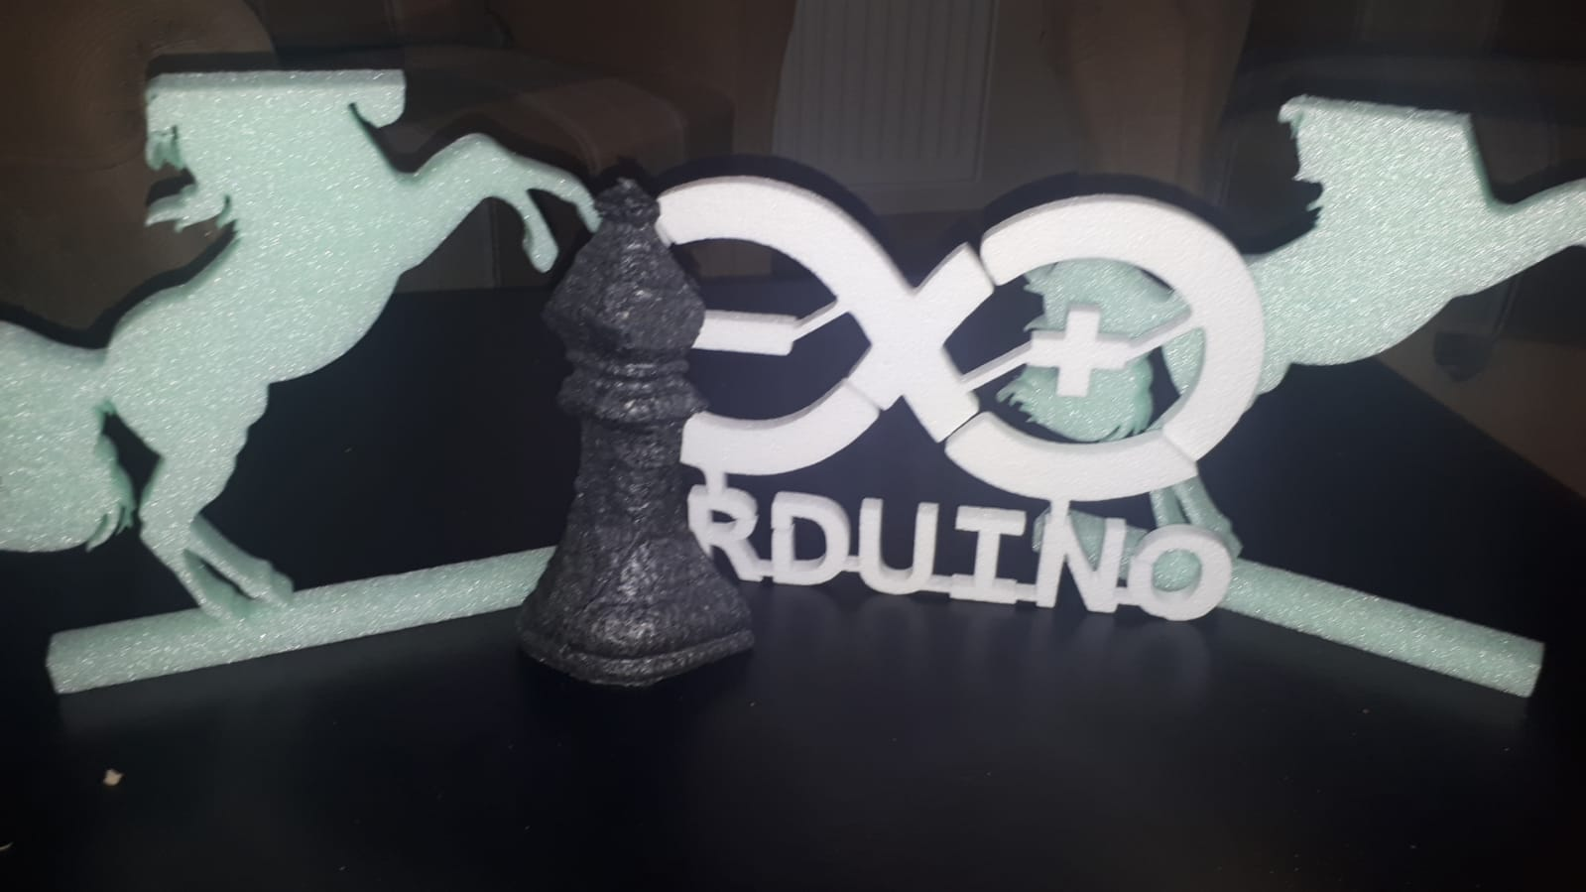
WORKSHOP

Slide 22

FOAM CUTTING MACHINE
Thank you for listening… Any Question?

